Slide 1

Test Your Skills

Slide 2
Exercise 1 (Plickers) ⬇⬇⬇⬇⬇
What is the yum command ?
A configuration software tool
A troubleshooting software tool
An automated uninstallation program
A package management program
Notes:
Yellowdog Updater Modified

Slide 3
Exercise 2 (Plickers) ⬇⬇
In the gdb debugger, typing character ‘n’ means:
‘next’ - Step into the next function.
‘new’ - Set a new breakpoint
‘next’ - Continue to the next source line
‘new’ – Create a new local variable
Notes:
Yellowdog Updater Modified

Slide 4
Exercise 3 (Plickers) ⬇⬇⬇⬇⬇
What does the following command do?
#git -d /cs161_cvsroot init
Create a git root
Create a git repository
Delete a git root
Delete an initial git root
Notes:
Yellowdog Updater Modified

Slide 5
Exercise 4 (Plickers) ⬇
What does the following command do?
%tar vfcz <group_ID>_project1.tgz .
Create a single compressed file for project 1
Uncompress files for project 1
Validate files of project 1
Install files of project 1
Notes:
Yellowdog Updater Modified

Slide 6


Notes:
When it comes to project 1, most COMP3500 students like to follow the Nike creed: Just do it!
When you follow a list of instructions, you should focus on the meaning of each command.

Slide 7


Notes:
When it comes to project 1, most COMP3500 students like to follow the Nike creed: Just do it!
When you follow a list of instructions, you should focus on the meaning of each command.

Slide 8
COMP 3500 Introduction to Operating Systems Project 2 – How to use grep?
Dr. Xiao Qin
Auburn University http://www.eng.auburn.edu/~xqin
xqin@auburn.edu
Notes:
Fall’17: 15 minutes 03b1-how to modify OS161 and 45 minutes for the next 03b2-process control. New schedule in Spring 2017. This lecture is scheduled on Lec03b.
Fall’16: Should give this lecture on Lec03a or Lec03b.

Slide 9
A Tool for Code Reading
You must learn how to use “grep” to improve your source code reading skill.
%grep –r “stack” .
%grep “stack” *.h
Notes:
See also 03a-Project 2 Demo-Manual.doc
6.
cs161/src
grep –r “stack” . |more

Slide 10


Slide 11
Exercise: Code Reading: An Example
2. What bus/busses does OS/161 support?
You must search the source code using the most appropriate keywords
%cd ~/cs161/src/kern/arch/mips/mips
%grep ‘bus’ *.c

Slide 12
Attention!
Please note that missing package in CentOS 7 may cause the installation errors. Please try the following command to install the missing package prior to the tool installations.
yum install ncurses-devel

Slide 13
Why ncurses-devel?
Problem without ncurses-devel: While trying to configure the cs161-gdb for Project 2, I am encountering a build error: "no termcap library found".
Solution: yum install ncurses-devel

Slide 14
Cs161-gdb Build Errors
Solution: Set up the compilation flag variable CFLAGS.
Step 1: extract the special gdb tarball
Step 2: $export CFLAGS="-g -O2 -Wno-error"
Step 3. run the toolbuild.sh script
Notes:
Don’t treat warning messages as errors in gdb.
This problem can be fixed by setting up the compilation flag variable CFLAGS. Please follow the three steps below:
Step 1: extract the special gdb tarball
Step 2: $export CFLAGS="-g -O2 -Wno-error"
Step 3. run the toolbuild.sh script

Slide 15
Cs161-gdb Build Errors (cont.)
Problem: We changed CFLAGS, but we got an error that we've changed CFLAGS and it quits after that.
Solution: After you change CFLAGS, you must delete all of the config.cache files and rebuild everything.
Step 1: cd ~/cs161
Step 2: rm -f ./*/config.cache
Step 3: rm -f ./*/*/config.cache
Once you finish the three steps, you must rebuild everything.
Notes:
After you change CFLAGS, you must delete all of the config.cache files and rebuild everything. To delete the config.cache files, please carry out the following steps:
Step 1: cd ~/cs161
Step 2: rm -f ./*/config.cache
Step 3: rm -f ./*/*/config.cache
Once you finish the above steps, you should rebuild everything in order.

Slide 16
Compilation Errors
Problem: When I try to run make depend to make the kernel, I get the following error:
/bin/sh: cs161-gcc: command not found make: *** [depend] Error 127
Solution: Use ‘echo $PATH’ to check your $PATH.
export PATH=~/cs161/bin:$PATH
You may need to add that statement to your .bashrc file.

Slide 17
COMP 3500 Introduction to Operating Systems Project 2 – Modifying OS/161
Dr. Xiao Qin
Auburn University http://www.eng.auburn.edu/~xqin
xqin@auburn.edu
Notes:
New schedule in Spring 2017.
Fall’16: Should give this lecture on Lec03a or Lec03b.

Slide 18
Modifying your kernel
Create a new file
~/cs161/src/kern/main/hello.c
Edit ~/cs161/src/kern/main/main.c
which calls the hello function
Before reconfiguring and rebuilding your kernel, you will need to edit
~/cs161/src/kern/conf/conf.kern

Slide 19
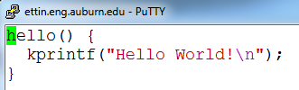
Your hello.c

Slide 20
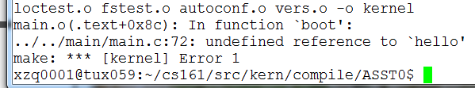
A Compilation Error

Slide 21
Edit kern/conf/conf.kern
cd ~/cs161/src/kern/conf
vi conf.kern
/main.c #search main.c in conf.kern see also line 374
Add the following line:
file main/hello.c

Slide 22
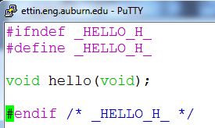
Create a header file: hello.h

Slide 23
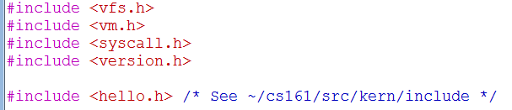
Add #include <hello.h> into main.c

Slide 24
Configure your source code tree
cd ~/cs161/src
./configure
Why this is important?
cd ~/cs161/src/kern/conf
./config ASST0
When should you reconfigure OS161?
Notes:
Answer: Prepare makefile
Answer: add new files. Want to automatically update makefile.

Slide 25
Build the ASST0 kernel.
cd ../compile/ASST0
make depend
make
make install
Why this is important?
Notes:
Answer: move the executable kernel into cs161/root

Slide 26
Build the user level utilties
cd ~/cs161/src
make
Run OS161
cd ~/cs161/root
./sys161 kernel
Notes:
Answer: move the executable kernel into cs161/root

Slide 27
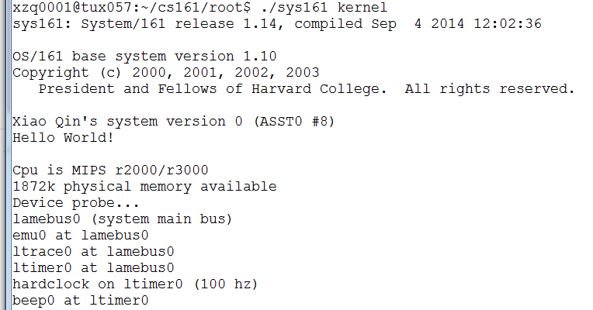
What do you expect?
Notes:
Answer: move the executable kernel into cs161/root

